Slide 1

Wireless Communication for IoT
Alaa Nabil

Slide 2
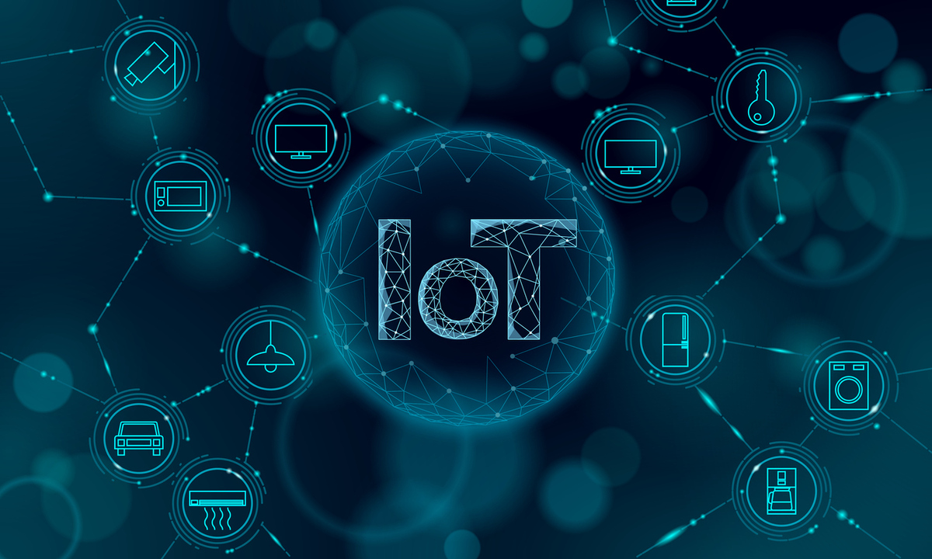
What’s IoT
Internet of things (IoT) is inter-networking of physical devices. This system has ability to transfer data over a network without requiring human to human or human to computer interaction.

Slide 3
IoT Life Cycle
Collect
Communicate
Analyze
Act

Slide 4
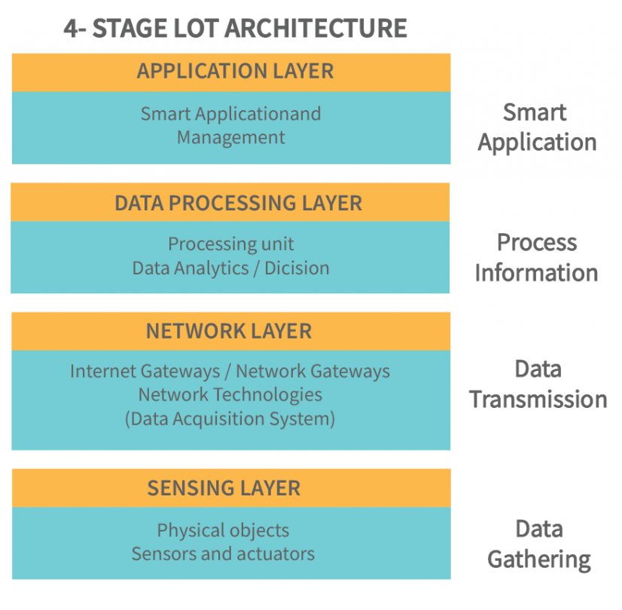
Architecture of IoT

Slide 5
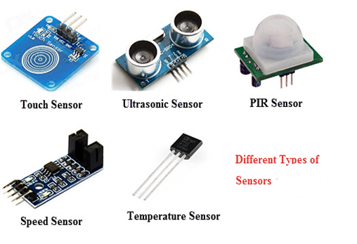
Sensing Layer (Sensors)
A sensor is: a device that detects and responds to some type of input from the physical environment.
The specific input could be light, heat, motion, moisture, pressure, or any one of a great number of other environmental phenomena.
The output is generally a signal that is converted to human-readable display at the sensor location or transmitted electronically over a network for reading or further processing.

Slide 6
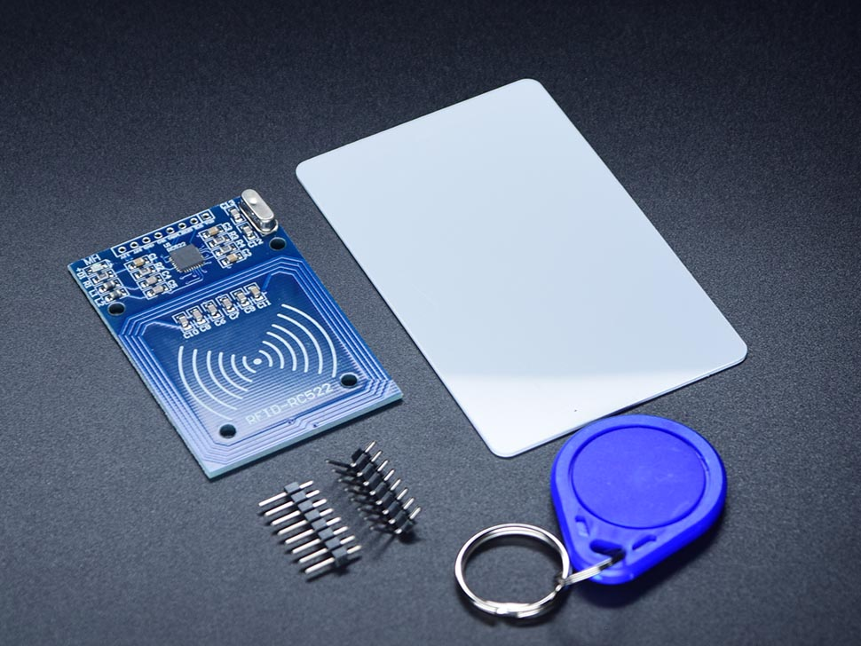

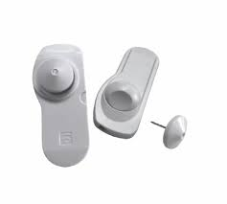
Sensing Layer (RFID Tags/Readers)
Passive
Active
Semi-Passive

Slide 7
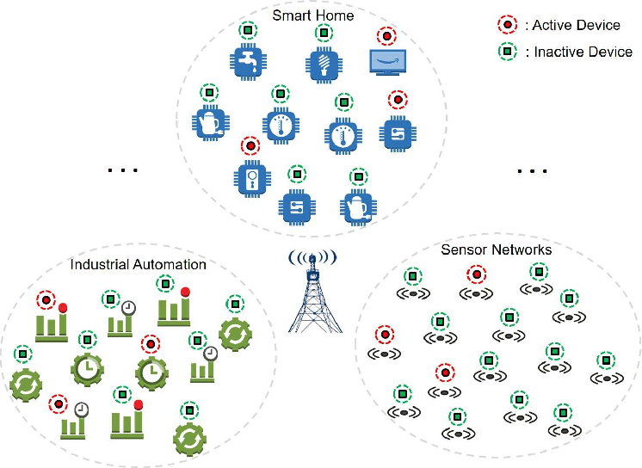
Network Layer
High Power Consumption, High Range, High Bandwidth
Connectivity options in this group include cellular and satellite.
High Power Consumption, Low Range, High Bandwidth
Connectivity options in this group include WiFi, Bluetooth.
Low Power Consumption, High Range, Low Bandwidth
Connectivity options in this group are called Low-Power Wide-Area Networks (LPWAN) or LoRaWAN and Zigbee.
Low Power Consumption, low Range, Low Bandwidth
Connectivity options in this group include BLE, NFC, RFID
Power Consumption
Range
Bandwidth

Slide 8
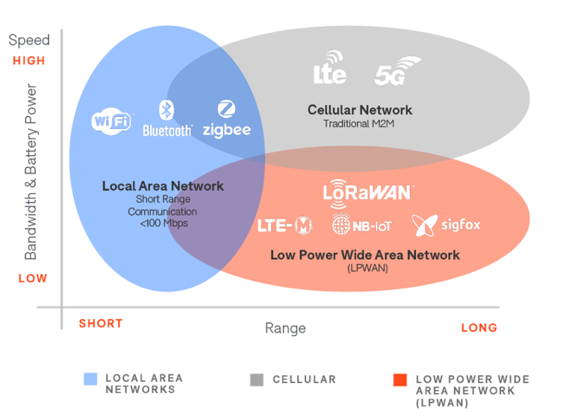
LPWANs

Slide 9
Block Diagram of Wireless Communication Systems
ADC
Source Encoding
Channel Encoding
Encryption
Compression
Modulation

Slide 10
Why converting to Digital Signals?!
Flexibility
Precision and Accuracy
Noise Immunity
Storage
Notes:
Flexibility: Digital signals can be easily manipulated, processed, and modified using mathematical algorithms

Slide 11
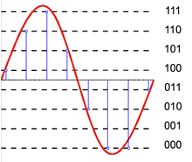
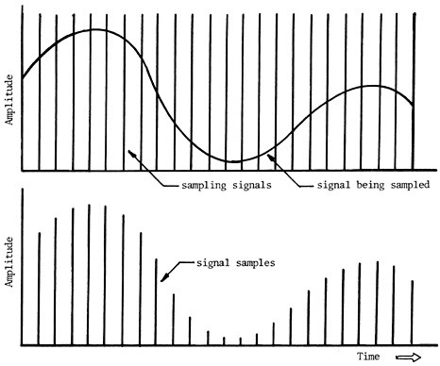
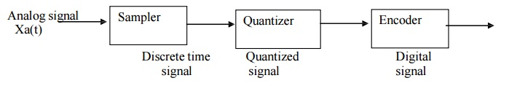
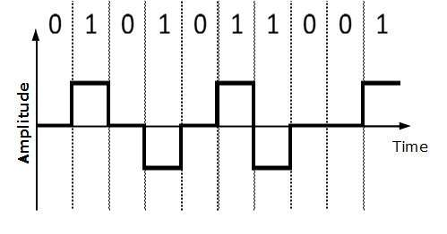
ADC

Slide 12
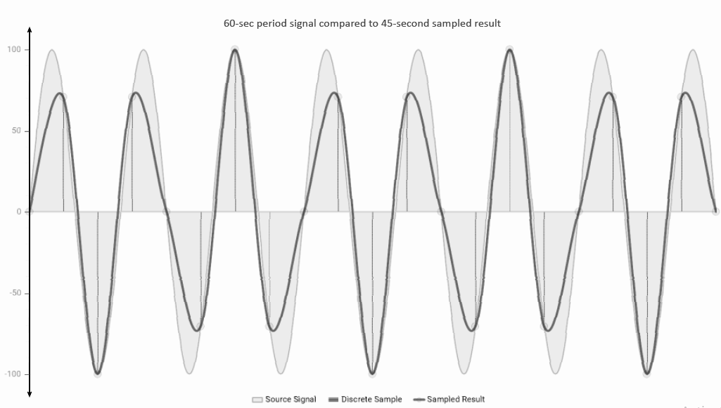
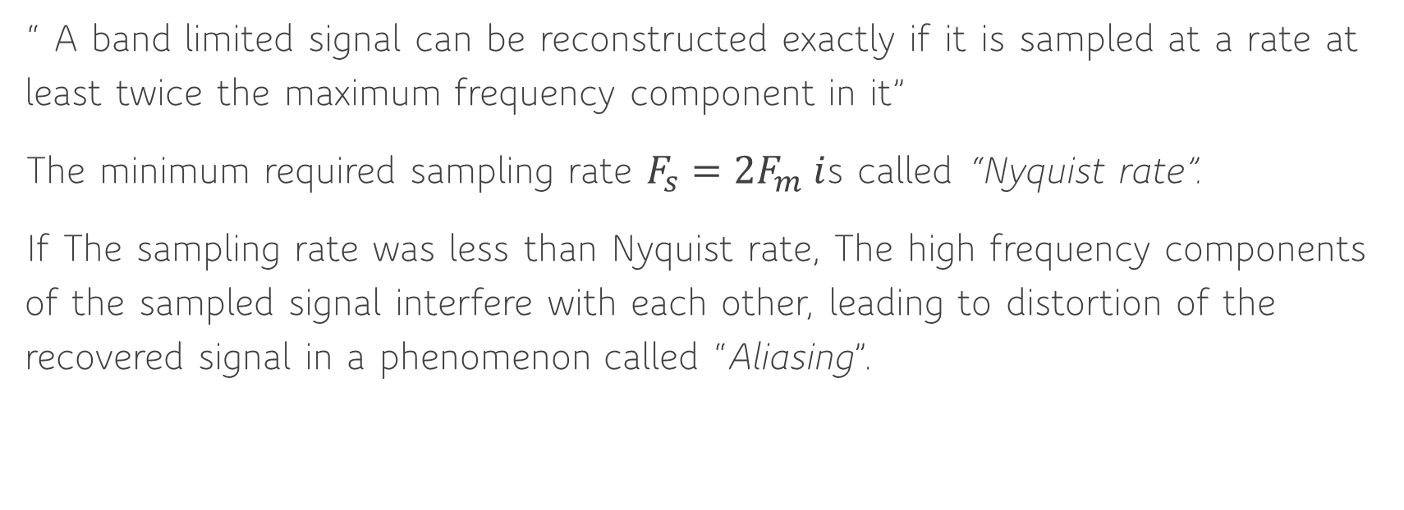
Sampling Theorem “Nyquist Rate”
“ A band limited signal can be reconstructed exactly if it is sampled at a rate at least twice the maximum frequency component in it”
The minimum required sampling rate $F_{s}=2F_{m} i$s called “Nyquist rate”.
If The sampling rate was less than Nyquist rate, The high frequency components of the sampled signal interfere with each other, leading to distortion of the recovered signal in a phenomenon called “Aliasing”.

Slide 13
Modulation
Modulation is the process of modifying a carrier signal, typically a high-frequency waveform, to encode the information from the source. It involves altering the characteristics of the carrier signal, such as amplitude, frequency, or phase, in accordance with the input signal carrying the desired information.
Modulation allows the information to be transmitted over a physical medium, such as a wire or through the air, by "modulating" the carrier signal with the source information.

Slide 14
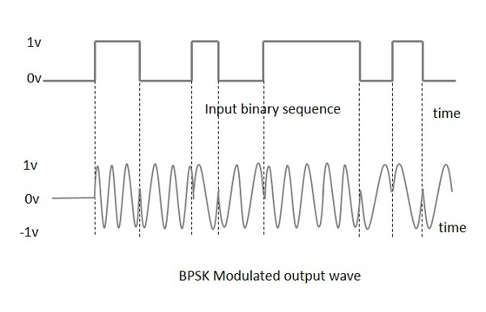
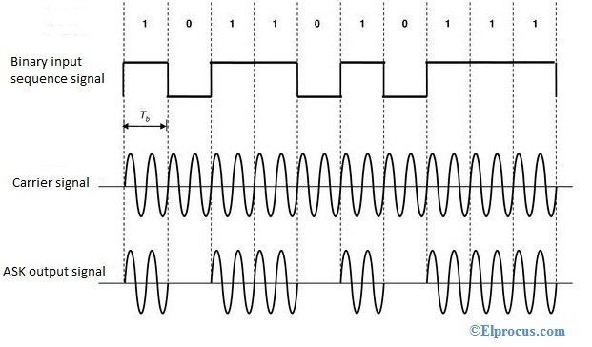
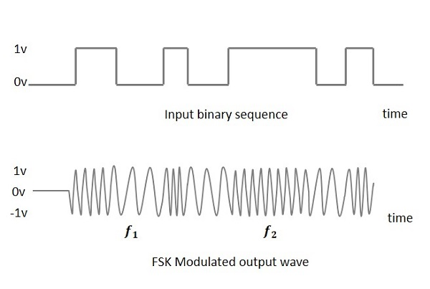
Types of Digital Modulation
ASK
FSK
PSK

Slide 15
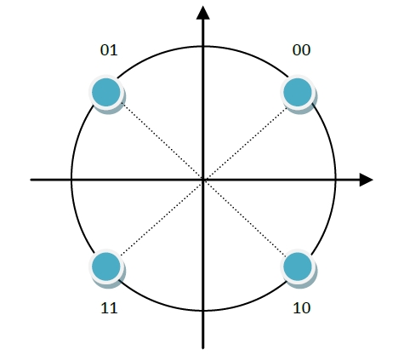
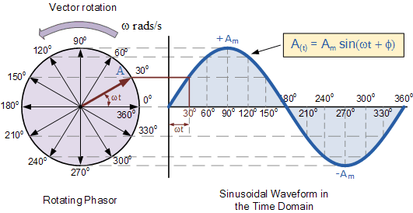
Phasor Diagram/Constellation Diagram

Slide 16
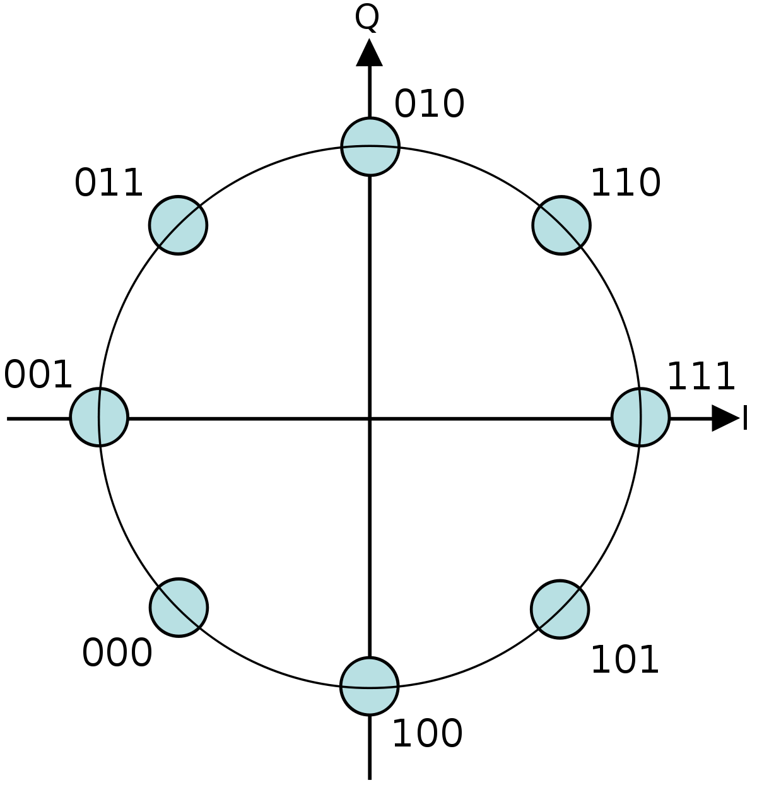
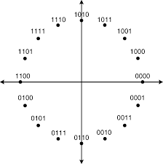
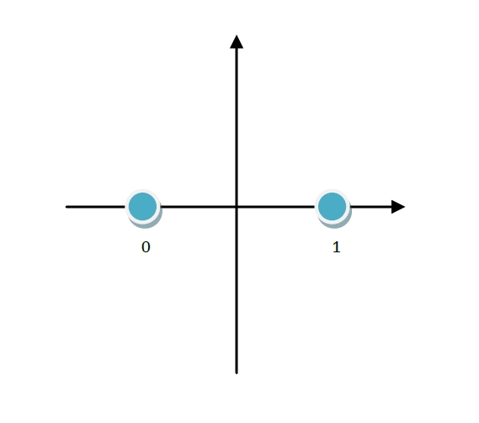
PSK Modulation
QPSK
8-PSK
16-PSK
BPSK
Notes:
https://www.youtube.com/watch?v=lDSzyEQKE6o
https://www.youtube.com/watch?v=IbUflaeJcU8

Slide 17
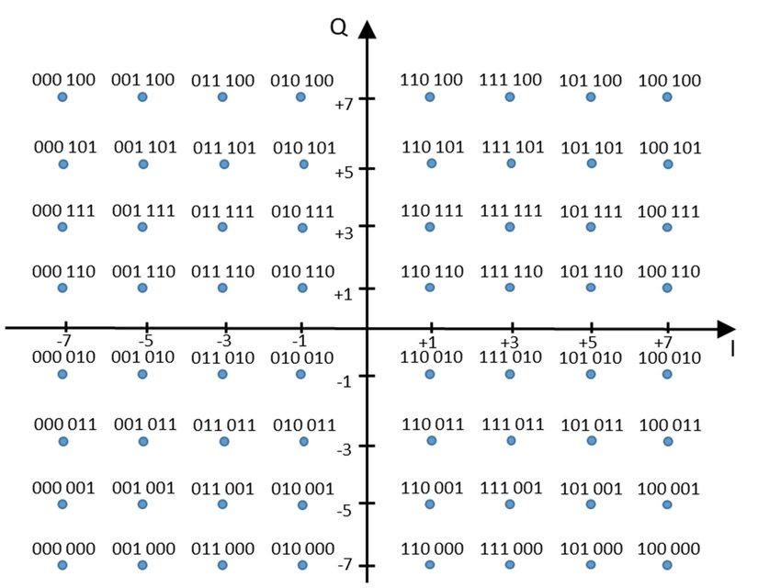
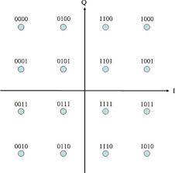
We can also change Amplitude(QAM)

Slide 18


Matlab

Slide 19
What We need to Learn Today
Use Help.
Matrix Manipulation.
Define a Matrix manually.
Use built-in functions to create matrices: ones, zeros, linspace, randn, randi.
Matrix Operations: reshape, repmat,size, length, find, sum.
Drawing functions.
Plot
stem
Figure
Hold on
Communication Toolbox.
pskmod/pskdemod
Scatter
biterr

Slide 20
What We will Try Today
Write a MATLAB script to do the following:
Generate random bit stream of size 5, and Plot the Modulated Signal with fc = 1 Hz.
(signal = A*cos(2*pi*f*t))
Generate random bit stream of size 100, Simulate BPSK Modulation and observe the constellation diagram. Simulate BPSK Demodulation and compare the output to the original bit stream –Hint: use communication toolbox.

Slide 21
Any Questions

